Slide 1
What is your Professional Code of Ethics, and do you have the Moral Courage to uphold it?
Mark D. Mensack, AIFA
Chief Ethics Officer
Piedmont Independent Fiduciaries
2011 FI360 Conference
San Antonio, Texas

Slide 2
Ethics on Wall Street
The Securities Exchange Act of 1934 states that securities in transactions are affected with the national interest, and must be conducted so as to protect interstate commerce and to insure the maintenance of fair and honest markets in such transactions. These general mandates require that market participants operate with the highest ethical standards and integrity and comply with all laws and rules intended to achieve these goals.
“The Commission’s mission starts with an uncompromising commitment to the highest ethical standards…”
SEC General Counsel David Becker, 08/05/10
“These capitalists generally act harmoniously and in concert, to fleece the people”
Lincoln

Slide 3
Ethics on Wall Street
The foundational rule in FINRA's rather large rule book is an ethical one: that brokerage firms must conduct their business in accordance with "high standards of commercial honor and just and equitable principles of trade.“
Mary Shapiro, CEO, FINRA 10/14/08
What's most important of all is for market participants—from senior executives to individual investors—to possess a commitment to ethics, integrity, and professional responsibility.
Rick Ketchum, CEO, FINRA, 10/2/09

Slide 4
Ethics on Wall Street?
The financial services industry is at a crossroads - we are faced with a little-before seen crisis in the global economy and several instances of publicized lapses in professional ethics.
“Enhancing Professional Conduct in the Financial Services Industry” FINRA
“Wall Street’s moral lapses call into question the moral justification for capitalism.”
Joseph Grundfest SEC Commissioner, 1987
“Wall Street needs to re-establish trust, honesty…
John Mack, October 13, 2010

Slide 5
Ethics on Wall Street?
In Gallup's 2009 polling just 19% said the honesty and ethical standards of bankers were high; 12% felt that way about business executives, and 9% about stockbrokers. Stockbrokers were tied with members of Congress. Both ranked only slightly above HMO managers (8%) and car salesmen (6%), who took last place in the poll.
Forbes 4/5/10 Karlyn Bowman
There are many professions in which one can find examples of hollow values, but nowhere is it more evident than on Wall Street…
Jon Huntsman, Winners Never Cheat
I believe that banking institutions are more dangerous
to our liberties than standing armies. Thomas Jefferson

Slide 6
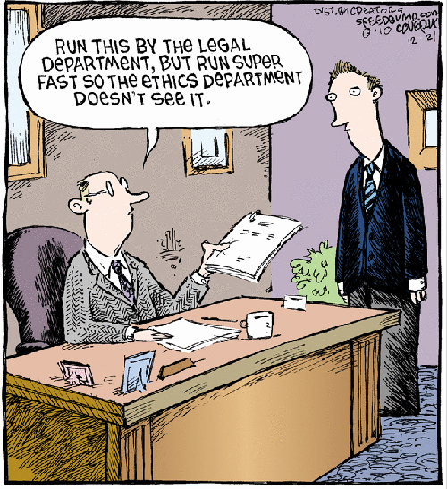
Laws control the lesser man. Right conduct controls the greater one. ~Chinese Proverb

Slide 7
What is a Professional?
The driving force of any profession includes not only the special knowledge, skills and standards that it demands, but the duty to serve responsibly, selflessly and wisely, and to establish an inherently ethical relationship between professionals and society.
JOHN C. BOGLE 4/21/09
“If I know he’s a salesman, I will evaluate his recommendations differently,…
When he is an adviser, I don’t question him, I assume he is a better expert than I am.”
Tamar Frankel, Boston University

Slide 8
Are you a Professional?
Expert and specialized knowledge
High quality work
The professional owes a higher duty to a client
Often the professional is required to put the interest of the client ahead of his own interests.
A high standard of professional ethics
You have to perform at a consistently higher level than others.
That's the mark of a true professional. Joe Paterno

Slide 9
AIF & AIFA Code of Ethics
Act with honesty and integrity and avoid conflicts of interest, real or perceived.
Ensure the timely and understandable disclosure of relevant information is accurate, complete, and objective.
Proactively promote and be a steward of ethical behavior…
Where is there dignity unless there is honesty?
Cicero

Slide 10
CFP Code of Ethics
Principle 1 - Integrity
  Integrity demands honesty and candor….
  Certificants are placed in positions of trust…
  Integrity cannot co-exist with deceit or subordination of one’s principles.
Principle 4 – Fairness
  Fairness requires impartiality, intellectual honesty and disclosure of material conflicts of interest.
  Fairness is treating others in the same fashion that you would want to be treated.

Slide 11
ASPPA Code of Professional Conduct
Professional Integrity
  Shall perform services with honesty, integrity, skill and care.
Disclosure
  Shall make full & timely disclosure…of all sources of compensation or other material consideration that the member or the member’s firm may receive…
Conflicts of Interest
  If the member is aware of any significant conflict between the interests of a principal and the interests of another party, the member should advise the principal of the conflict…

Slide 12
Fundamental Principles of Professional Investment Ethics
Ethical Understanding – Because investments are complicated, you have an obligation not to knowingly engage in an investment transaction either you or others do not sufficiently understand. This includes knowing the underlying source of returns or fess charged.
Trust & Fairness – Because you are dealing with others’ money either directly or indirectly, you have an obligation not to abuse the trust that others have either explicitly or implicitly placed in you to treat them fairly.
Investment Ethics, Sarah Peck

Slide 13
Trust & Fairness
“A broker has a fiduciary duty to the client where the broker knows, or should have known, that trust has been placed in that broker.”
Gouger v. Bear Stearns, 823F. Supp. 282, 288 (E.D. Pa. 1993))
Trust and confidence are the glue that holds the markets together. They're more important than money and more valuable than any commodity.
Mary Shapiro, CEO, FINRA 10/14/08

Slide 14
What is Fairness?
Informed Voluntary Consent
Both buyer & seller understand what they are giving up and what they are receiving in return.
Nether buyer nor seller is compelled to enter into the exchange as a result of coercion, severely restricted alternatives, or other constraints on their ability to choose.
Both buyer and seller are able at the time of the exchange to make rational judgments about its costs & benefits.
A Modal Evaluation of Sales Practices, David M. Holley

Slide 15
401k Industry Ethical Issues
Fees, Expenses & Compensation
Pilfering & Paltering
Disclosure & Transparency of Disclosure
Fiduciary Warranties
Moral Courage
"It is difficult to get a man to understand something when his salary depends on his not understanding it."
Upton Sinclair

Slide 16
Fees, Expenses & Compensation
“A fiduciary shall discharge his duties . . . for the exclusive purpose of:
  (i) providing benefits to participants and their beneficiaries; and
  (ii) defraying reasonable expenses of administering the plan...”
  ERISA §404(a)(1)(A)
Rather fail with honor than succeed by fraud.
Sophocles

Slide 17
Fees, Expenses & Compensation
“assure that the compensation paid directly or indirectly by [a plan to a service provider] is reasonable, taking into account the services provided to the plan as well as any other fees or compensation received by [the service provider] in connection with the investment of plan assets. The responsible plan fiduciaries therefore must obtain sufficient information regarding any fees or other compensation that [the service provider] receives with respect to the plans investments ….to make an informed decision whether the [service providers] compensation for services is no more than reasonable.”
DOL - Frost (97-15A) and Aetna (97-16A)

Slide 18
Participants’ & 401k Fees
There are over 72 million 401k participants in America invested in more than 483,000 plans which contain over $3 trillion in assets.
71% Believed they paid no fees
81% Believed it was very important/somewhat important in making investment decisions
401(k) Participants’ Awareness and Understanding of Fees, AARP, 2011
“…several billion dollars of revenue-sharing fees are being hidden annually from plan sponsors and plan participants…”
Jay Sanders, The CPA Journal, NYSSCPA, 2005
“There is an undisputable fact of investing: Gross returns of a given investment, minus
the costs of financial intermediation, equal the net returns actually delivered to investors.”
Jack Bogle, Vanguard

Slide 19

Why does it matter to the participant?
Participant
Contributions
Current
401k
Balance
Assets
Needed to
Retire
Excess
Fees
1% in excess fees over the average American’s working lifetime, reduces their nest egg at retirement by 28%.
DOL, EBSA Website

Slide 20
Why does this matter to the Plan Sponsor?
A fiduciary is personally liable for any losses the plan incurs by reason of its breach. A fiduciary who has breached its duty is liable to restore to the plan any profits the fiduciary made through its use of plan assets and for any other equitable or remedial relief deemed appropriate by the court, including removal of the fiduciary.
ERISA § 409
The DOL has taken the position that fiduciaries have a duty to know and evaluate indirect payments. In performing that evaluation, fiduciaries need to consider whether the total amounts received, directly and indirectly, by their service providers are reasonable. Further, fiduciaries must evaluate whether the payments cause potential conflicts of interest and, if so, whether the plan and participants are protected from those conflicts…The failure to evaluate those issues is a fiduciary breach.
Revenue Sharing: What Is It , Fred Reish
Notes:
Slides 15-18 in response to “What do you mean, personal liability?”
I’ll talk through Sanctions and they are summarized on slide 14

Slide 21
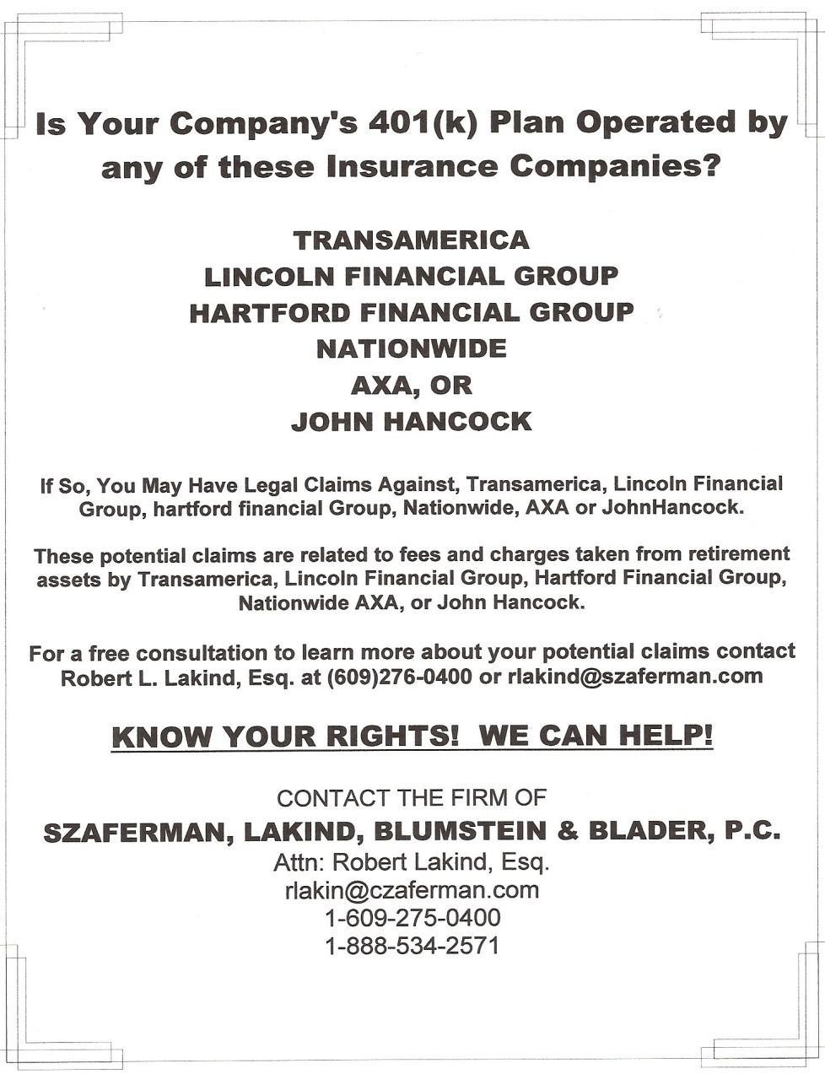
Newark Star-Ledger
August 2010

Slide 22
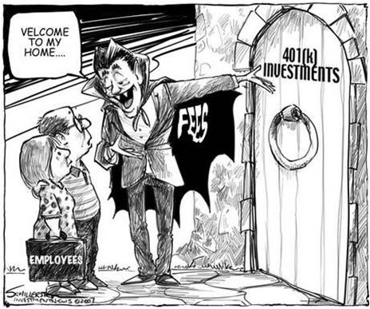

Slide 23
Two Ethical Issues
Failure or refusal to fully disclose fees, expenses, revenue sharing, and other hidden costs is causing hundreds of thousands of 401(k) and similar plans to operate outside the realm of fiduciary prudence, unknowingly engage in prohibited transactions, and unnecessarily erode the future benefits belonging to participants and beneficiaries.
Matthew D. Hutcheson, Congressional Expert,
Ethical Principles and Legal Obligations, July 2007

Slide 24
West Point Honor Code
A Cadet will not lie, cheat, steal, or tolerate those that do.
Cadets violate the Honor Code by lying if they deliberately deceive another by stating an untruth or by any direct form of communication to include the telling of a partial truth and the vague or ambiguous use of information or language with the intent to deceive or mislead.
At West Point, this form of lying is called “quibbling”.
Ethically speaking its called “paltering.”
A half truth is a whole lie. ~Yiddish Proverb

Slide 25
Deceptive Behaviors
CAIN Analysis
Context | Action | Intention | Example
Entertainment | Truth not necessary | False or misleading info | Misdirection, intrigue | Movies, novels, magic acts, poker
Etiquette | Truth preferred, but not necessary | Incomplete information | Kindness or respect | "Does this make me look fat?" Tact.
Mistake | Truth expected | Factually incorrect info | Tell the truth | Misremembers
Lying | Truth expected | Factually incorrect info | Mislead, deceive | Lies; steroids in sports
Paltering | Truth expected | Factually correct but incomplete or out of context | Mislead, deceive | Innuendo; Partial truths "lies of omission"
Lying and Paltering, Bennett Blum, MD

Slide 26
Pilfering & Paltering
Pilfer - to steal repeatedly, especially in small amounts so to go unnoticed
Palter - to intentionally deceive or mislead without making a false statement in order to advantage one’s self and /or disadvantage another
The least initial deviation from the truth is multiplied later a thousand-fold. ~Aristotle

Slide 27
Types of Paltering
Equivocation: making an indirect, ambiguous, or contradictory statement. To use one word but for multiple meaning, or two words with the same meaning.
ABC Firm receives payments of up to 0.15% on new asset purchases made by the plan. These payments may be referred to as “revenue sharing” under some circumstances. The payments are made by the XYZ Company to ABC Firm. Your Financial Advisor does not receive any part of these payments. Amounts payable by XYZ Company to ABC Firm do not result in an additional direct charge to your Plan or to the products, except to the extent XYZ Company applies an asset charge or other charge and pays compensation to ABC Firm from it’s general revenues.

Slide 28
Types of Paltering
Concealment: omitting information that is material to the context, or hiding material information
Fiduciaries are required to know all expenses that are being paid by the plan, directly or indirectly, and to determine if they are reasonable (that is, whether the expense is competitive in the marketplace and whether the plan and its participants receive value commensurate with the cost). In addition, the advisor should be able to explain the structure of the compensation he or she individually receives from each investment. Fiduciaries are not required to choose the least expensive services; rather, they should ensure that they are getting good value for the plan’s money.

Slide 29
Concealment
Needle in a Haystack QUIZ
How many pages of documentation must a plan sponsor review in order to read all of the available information regarding fees, compensation & potential conflicts of interest?
(Lets assume there is just one mutual fund in the plan!)
a) 127
b) 539
c) 827

Slide 30
Concealment
Prospectus – 72 pgs
  9 pages
SAI– 285 pgs
  17 pages
Annual Report – 44 pgs
  - 6 pages
Semi-Annual Report – 36 pgs
  8 pages
Group Annuity Contract – 33 pgs
  5 pages
Plan Level Documents – 58 pgs
  9 pages
Adm Service Agreement – 11 pgs
  2 pages
  539 pages! 56 references to fees,
  compensation, and potential conflicts of interest
It doesn't require many words to speak the truth - Chief Joseph

Slide 31
Paltering & Federal Trade Commission Act
The FTC defines deception as: be a representation, omission or practice that is likely to mislead the consumer.
Under Section 5, the Commission has determined that a representation, omission, or practice is deceptive if: (1) it is likely to mislead consumers acting reasonably under the circumstances; and (2) it is material, that is, likely to affect consumers' conduct or decisions with respect to the product at issue.
The FTC said that “disclosures that are required to prevent deception or to provide consumers material information about a transaction must be presented clearly and conspicuously.”

Slide 32
Paltering in Plain Sight
But ethical misconduct doesn't need to reach criminal levels in order to harm investors. What we often see is a culture of neglect or rationalization, where the pursuit of profit obscures a sense of any moral obligation to the investor.
Mary Shapiro, CEO, FINRA 10/14/08
It is not necessary that whilst I live I live happily; but it is necessary that so long as I live I should live honorably. Immanuel Kant

Slide 33
Paltering in Plain Sight
Retail vs. Wholesale
 | A | R-1 | R-2 | R-3 | R-4 | R-5 | R-6
Management fees | 0.43% | 0.43% | 0.43% | 0.43% | 0.43% | 0.43% | 0.43%
Distribution and/or service (12b-1) fees | 0.24 | 1.00 | 0.75 | 0.50 | 0.25 | none | none
Other expenses (Sub-TA Fees) | 0.18 | 0.21 | 0.48 | 0.22 | 0.18 | 0.13 | 0.09
Total annual fund operating expenses | 0.85 | 1.64 | 1.66 | 1.15 | 0.86 | 0.56 | 0.52
Integrity has no need of rules. Albert Camus

Slide 34
The Epitome of Paltering
Group annuity contracts are often more complex than plan sponsors realize, riddled with hidden charges and lock-up periods… Marketing materials touted low-cost to employers, but left out all of the charges their workers would be subjected to.
Forbes, Retirement Plans From Hell
“While we acknowledge and agree that situations in which the sale of a variable annuity within a qualified plan are limited, and that the suitability of all such sales should be closely scrutinized…”
Jude A. Curtis, Senior Vice President & Chief
Compliance Officer, John Hancock, Aug 9, 2003

Slide 35
The Epitome of Paltering
 | 1 mo. | 3 mos. | YTD | 1 yr. | 3 yrs. | 5 yrs. | 10 yrs. | Since* Inception | Expense Ratio
Vanguard Target Retirement 2030 Ret Opt | -0.54 | 10.59 | 7.58 | 9.53 | -3.67 | N/A | N/A | 1.90 | 0.94
Performance shown is average annual total separate account investment choice
returns (except 1 month, last quarter, and year-to-date) for the period indicated,
net of the total operating expenses of the separate account or underlying investment
as listed on the individual investment fact sheets. Performance returns reflect
reinvestment of dividends and capital gains distributions. Application of the contract
asset charge and any discontinuance charges or service fees deducted from the
account would reduce this return.
Group Annuity 401k Participant Website

Slide 36

Why would anyone knowingly pay
3% to 5% in 401k fees?
I cost 1.3%
Whatever happened to doing what’s right? John Mack, 7/7/10, Queens University

Slide 37

They wouldn’t!
I cost 1.3%
I cost 1.21%
I cost 0.37%
I cost 0.25%
Expense
Ratio
I cost 1.51%
IM & A
Charge
Annual Charges
& Fees
Contract Asset
Charge
Transaction
Costs
"Pay no attention to the man behind the curtain" Wizard of Oz

Slide 38
Paltering & Pilfering?
1.30% Total Expense Ratio
1.21% Investment Management & Admin Charge
0.37% Annual Charges & Fees
0.25% Contract Asset Charge
1.51% Transaction Costs
4.64% Actual Cost
Honesty pays, but it doesn't seem to pay enough to suit some people.
Frank McKinney "Kin" Hubbard

Slide 39
A Note of “Transaction Costs”
Broker-dealer costs for securities transactions within a mutual fund are not reportable under the new fee disclosure rule; however:
In order to be Rule 404(c) compliant: The participants or beneficiary is provided…the following information, which shall be based on the latest information available to the plan: (i) A description of the annual operating expenses of each designated investment alternative (e.g., investment management fees, administrative fees, transaction costs) which reduce the rate of return to participants and beneficiaries… ERISA 404c-1 (2)
I am not bound to win, but I am bound to be true. I am not bound to succeed,
but I am bound to live by the light that I have. I must stand with anybody that stands right,
and stand with him while he is right, and part with him when he goes wrong.” Lincoln

Slide 40
Paltering with Mouse Print
Fiduciary Warranties
“This unprecedented program offers plan sponsors and fiduciaries greater confidence, security and peace of mind by providing specific assurance for their fund selection. We’re so confident, we promise to restore any losses to the plan and pay litigation costs related to the suitability of our investment process and Fund lineup for 401(k) plans.”
“We recognize that fund selection and monitoring is an important part of the due diligence process for plan fiduciaries, and we are confident that our investment selection and monitoring process meets the highest standards. We are willing to put our name behind the Funds selected from our investment lineup and promise that our Funds….”
“…we are committed to helping you meet the highest fiduciary standards in the investment selection and monitoring process and commit to restore losses and pay litigation costs in the event that legal action is brought against qualifying plans. Now that’s security for your plan!”

Slide 41
Paltering with Mouse Print
Fiduciary Warranties
“…since past performance is not a guarantee of future results, we cannot warrant or guarantee either that any investment option will yield any specific return, or even that it will yield a positive return. Nor does our Fiduciary Standards Warranty extend to claims that any expenses paid directly or indirectly by the Plan are reasonable.”
“This witch’s brew of hidden fees, conflicts of interest and complexity in application
is at odds with investors’ best interests.” Christopher Cox, Chairman, SEC

Slide 42
Moral Courage
Ethics is all about how we meet the challenge of doing the right thing when the act will cost more than we want to pay.
Michael Josephson
Courage is not the understanding of what is right or wrong. Rather, it is the strength to choose the right course.
Jon Huntsman, Winners Never Cheat
Encourage us in our endeavor to live above the common level of life. Make us to choose the harder right instead of the easier wrong, and never be content with a half-truth when the whole can be won. West Point Cadet Prayer

Slide 43
Moral Courage
401k Plan Sponsors have a fiduciary duty to discover all fees being paid from plan assets; all compensation being paid to any interested party; and to evaluate those fees and compensation relative to the services being provided.
Failure to fulfill this duty puts the plan sponsor in personal jeopardy, and threatens the retirement income security of plan participants.
As a AIF/AIFA or CFP Designee, or as a member of ASPPA, what is your ethical obligation if you are providing a service to a Plan Sponsor who is unaware of the fees and/or compensation within their 401k plan?
“Moral courage is a more rare commodity than bravery in battle or great intelligence.” RFK

Slide 44
Moral Courage
Act with honesty and integrity
Proactively promote and be a steward of ethical behavior…
Integrity demands honesty and candor….
Integrity cannot co-exist with deceit
Intellectual honesty
Fairness is treating others in the same fashion that you would want to be treated. If the member is aware of any significant conflict between the interests of a principal and the interests of another party, the member should advise the principal of the conflict…

Slide 45
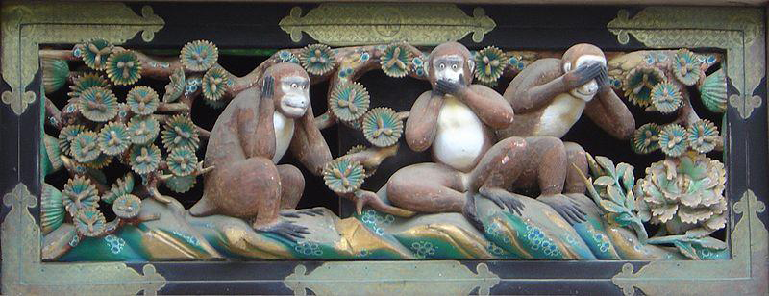
The Three Wise Monkeys
You will never do anything in this world without courage.
It is the greatest quality of the mind next to honor. Aristotle

Slide 46
So, I guess the point you want to walk away with, and I don’t know if its leadership or responsibility, but when you take on a job.…it wouldn’t have to be a big job… you have a responsibility to do what you think is right, and stand up sometimes when the odds are against you and people are pushing you. I think that there are enough stories you can read about in the paper where if people would have done that, they wouldn’t be in the pickle they are in now. So I guess if you leave here and the thing to think about is, stand up for what you believe in, do what you think is right, be prepared to suffer the consequences. But don’t be pushed around when you know in your heart of hearts that it’s the wrong thing to do.
John Mack, “Leadership in Crisis” Oct 2009

