Slide 1
Retirement Plans, The Wizard of Oz
& the SHRM Code of Ethics:
Understanding the Ethical Imperative
of Fiduciary Responsibility
Mark D. Mensack, AIFA®, GFS®
May 2013
Boston | Great Lakes Region | Philadelphia Metro | Nashville | New York Metro | Tampa | Washington, D.C.
(856) HIT-401K | www.PrudentChampion.com

Slide 2
The Wizard of Oz & Retirement Plans
“Pay no attention to that man behind the curtain.”
Professor Marvel’s Magical Elixir aka Snake Oil comes from the 19th-century American practice of selling cure-all elixirs in traveling medicine shows. Snake oil salesmen would falsely claim that the potions would cure any ailments. Now-a-days it refers to fake products. Urban Dictionary

Slide 3
AGENDA
Moral Hazard
Ethics on Wall Street?
Ethical vs. Legal Obligations
Negative & Affirmative Ethical Obligations
  SHRM Code of Ethics
Voluntary UNinformed Consent
Suitability vs. Fiduciary Standards
The Moral Hazard of Suitability
Suitability Standard in Action

Slide 4
Moral Hazard
“Moral hazard may exist anytime there is difficulty or cost associated with monitoring and enforcing the behavior of a party with interests that are in conflict with our own.”
Richard Lindsey, former Director, SEC Division of Market Regulation
Moral hazard is "any situation in which one person makes the decision about how much risk to take, while someone else bears the cost if things go badly.“ Economist Paul Krugman

Slide 5
Moral Hazard
Information Asymmetry occurs when one party to a transaction has less information upon which to base a decision than the other party.
Risk Asymmetry occurs when the risk faced by the parties involved is significantly lop-sided.
In the 401k arena, 401k service providers typically have greater knowledge regarding the 401k product and a plan sponsor’s fiduciary duties than the plan sponsor.
A 401k service provider faces minimal, if any, risk in selling an imprudent 401k product, while a plan sponsor faces great risk for choosing an imprudent 401k product.

Slide 6
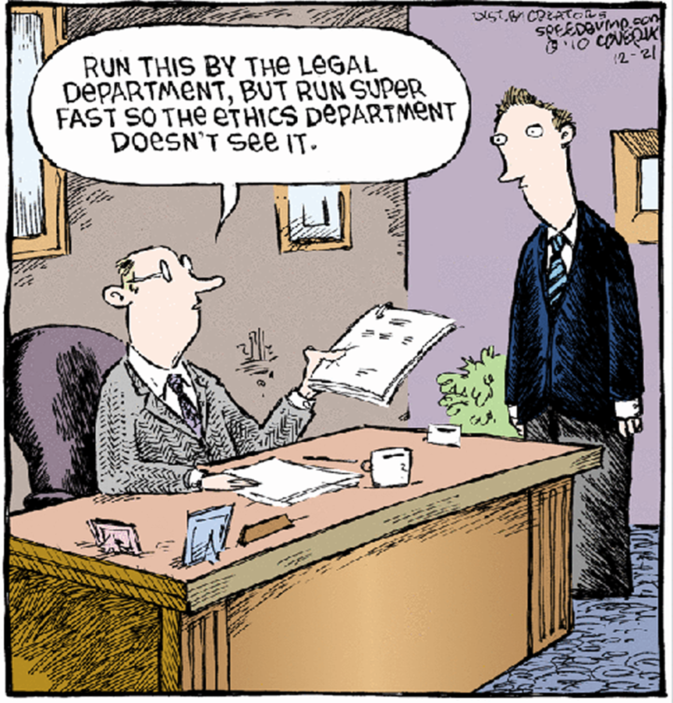
Ethics on Wall Street?

Slide 7
Ethics on Wall Street?
Goldman Sachs Business Principles
"Our clients' interests always come first. Our experience shows that if we serve our clients well, our own success will follow."
"We are dedicated to complying fully with the letter and spirit of the laws, rules and ethical principles that govern us. Our continued success depends upon unswerving adherence to this standard."
"Integrity and honesty are at the heart of our business."

Slide 8
Ethics on Wall Street?
Goldman’s attorney’s argument against an investor class action:
  "Further, the vast majority of the supposed "misstatements" alleged in the Complaint -- e.g., regarding the firm's "integrity" and "honesty" -- are nothing more than classic "puffery" or statements of opinion that, under well-settled law, cannot give rise to a securities fraud claim.“
United States District Court for the Southern District of New York
(In re Goldman Sachs Group, Inc. Securities Litigation: Master File No. 1:10-cv-03461)

Slide 9
Ethics on Wall Street?
“Puffery” has been described by one legal scholar as vague statements of corporate optimism that is often characterized as "so obviously unimportant to a reasonable investor that reasonable minds could not differ.“
Dan Solin in “'Puffery' Can Blow Away Your Retirement Goals”

Slide 10
Ethics on Wall Street?
"[I]f Goldman's claim of "honesty" and "integrity" are simply puffery, the world of finance may be in more trouble than we recognize.”
U.S. District Judge Paul A. Crotty, June 21, 2012

Slide 11
Ethics on Wall Street?
Haddock v. Nationwide
Haddock alleged that Nationwide was a fiduciary and its acceptance of revenue sharing compensation from the mutual funds within the Nationwide product was in violation of ERISA’s exclusive benefit rule.
Nationwide filed a counter-class action against all of the Haddock trustees arguing “that, to the extent the plans were harmed by its revenue sharing arrangement, the trustees (its clients!) were responsible to reimburse them because of their "...failure to exercise reasonable prudence and care.”
“If our conduct caused harm to the plan participants, it was our clients' fault for not being smart enough to put a stop to it.”
Dan Solin, Nationwide Tosses Its 401(k) Clients Under the Bus

Slide 12
Ethical vs. Legal Obligations
“…our free market economy and, indeed, our whole way of life, are built on trust – trust in the markets, and trust in our fellow citizens.” FBI Director Robert Mueller
“Ethical misconduct doesn't need to reach criminal levels in order to harm investors. What we often see is a culture of neglect or rationalization, where the pursuit of profit obscures a sense of any moral obligation to the investor.” Mary Shapiro, Commissioner of the SEC

Slide 13
Ethical vs. Legal Obligations
Gyges was a shepherd for the King. One day, there was an earthquake while Gyges was out in the fields, and he noticed that a cave had opened up on the side of a mountain. When he went to investigate, he discovered the tomb of an ancient King, and on the finger of the corpse was a gold ring. He took the ring and soon discovered that it allowed the wearer to become invisible. Gyges realized that if he was invisible, he could do whatever he desired with no fear of punishment. The next time he went to the palace to give the king a report about his sheep, he put the ring on, killed the king, seduced the queen, and ruled the land. Plato, The Republic
What would you do today with the ring, that you would not have done yesterday without it?

Slide 14
Ethical vs. Legal Obligations
Prohibited Transactions
ERISA § 406(a)(1)(c) prohibits plan assets to be used to pay ANY party in interest for ANYTHING! Violation of this statute is a prohibited transaction!
ERISA §408(b)(2) provides a prohibited transaction exemption only if three criteria are met:
  The services must be necessary for the operation of the plan;
  The services must be furnished under a contract or arrangement which is reasonable and;
  No more than reasonable compensation is paid for the service.

Slide 15
Ethical vs. Legal Obligations
A fiduciary must “engage in an objective process designed to elicit information necessary to assess the qualifications of the provider, the quality of services offered, and the reasonableness of the fees charged in light of the services provided. . . such process should be designed to avoid self-dealing, conflicts of interest or other improper influence.”
DOL Field Assistance
Bulletin 2002-3 (Nov. 5, 2002)

Slide 16
Ethical vs. Legal Obligations
There are over 72 million 401k participants in America invested in more than 483,000 plans which contain over $3 trillion in assets.
71% Believed they paid no fees
81% Believed it was very important/somewhat important in making investment decisions
401(k) Participants’ Awareness and Understanding of Fees,
AARP, 2011

Slide 17
Ethical vs. Legal Obligations
A penny saved is a penny earned.
Ben Franklin
1% in excess fees over the average American’s working lifetime, reduces their nest egg at retirement by 28%. DOL, EBSA Website
48% of plan sponsors did not know if their service providers had revenue sharing arrangements with other providers.
Government Accounting Agency, April 2012

Slide 18
Ethical vs. Legal Obligations
A fiduciary is personally liable for any losses the plan incurs by reason of its breach. A fiduciary who has breached its duty is liable to restore to the plan any profits the fiduciary made through its use of plan assets and for any other equitable or remedial relief deemed appropriate by the court, including removal of the fiduciary.
ERISA § 409

Slide 19
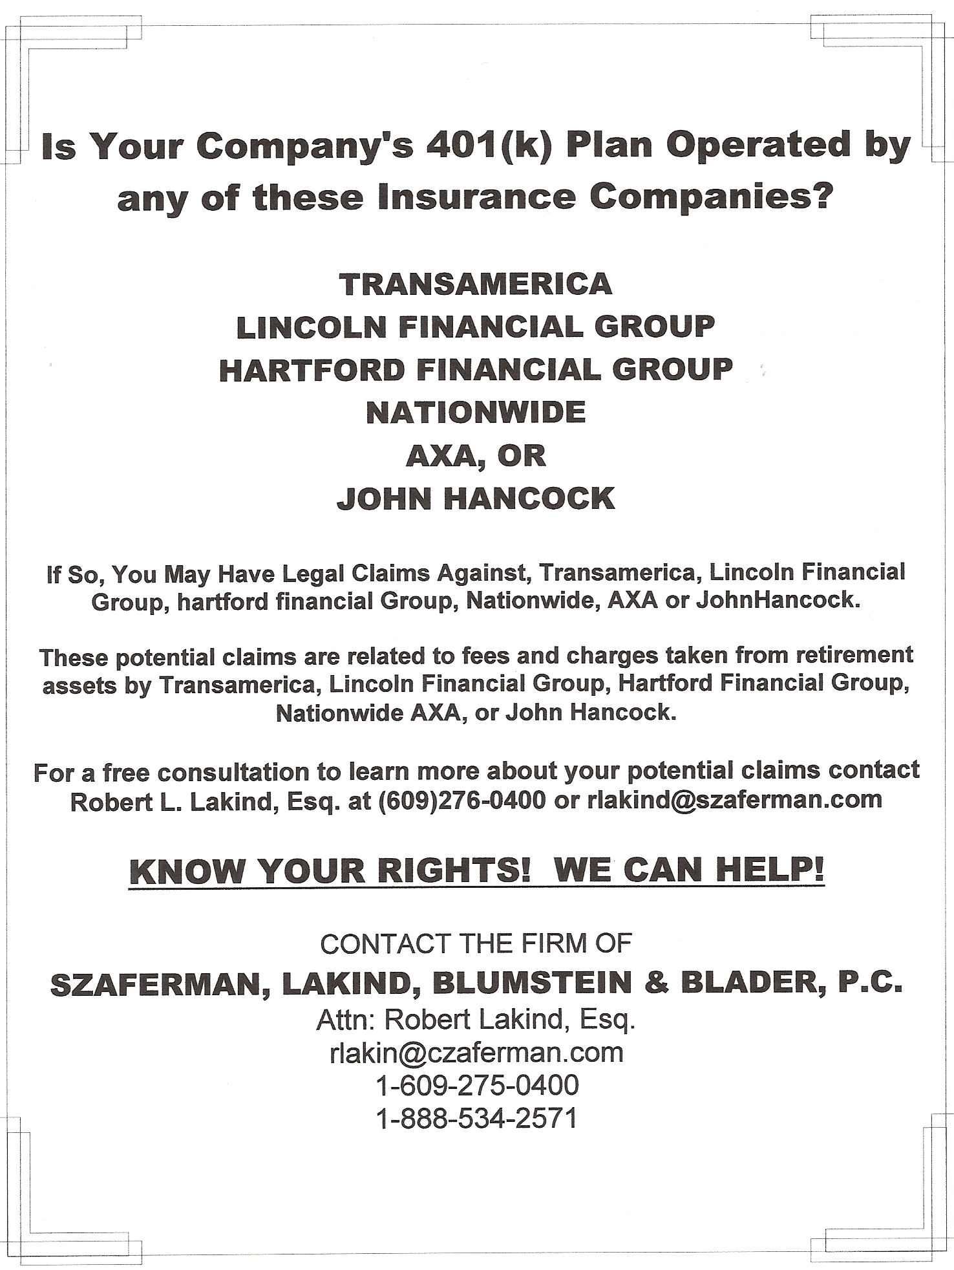
Newark Star-Ledger
August 28th, 2010

Slide 20
Ethical vs. Legal Obligations
Tussey v. ABB, Fidelity, et al
  “Counts should be dismissed against Fidelity because Fidelity defendants have no fiduciary status relevant to the plaintiffs’ claims.”
Haddock v Nationwide Life
  “If Nationwide Life is found to have violated ERISA by arranging for, receiving, and retaining payments from funds…then the Trustees are reckless and also at fault to the extent the Plans suffered harm…, because the Trustees had the ultimate responsibility for managing the Plan, and investing Plan assets.”
Charters v John Hancock
  John Hancock countersued their client (Charters) for breach of fiduciary duty, monetary contribution and indemnity for being negligent in hiring John Hancock in the first place.

Slide 21
Tussey v. ABB, Inc, Fidelity Trust, and Fidelity Management, Et Al
Alleged that the Plan Fiduciaries failed to discharge their fiduciary obligations by not properly documenting and monitoring Fidelity’s fees
ABB, Inc., the ABB pension and benefits committees, and the individuals serving on these committees (collectively “Plan Fiduciaries”) were found jointly and severally liable for $35.2 million in damages for violations of their fiduciary duty under ERISA
Fidelity was liable for $1.7MM in lost income related to float income it retained

Slide 22
Tibble v. Edison International
Participants alleged that the fiduciaries breached their fiduciary duty by selecting retail share classes rather than less expensive institutional share classes
Court was troubled by fact that the fiduciaries never asked if lower cost share classes were available or if the minimum investment thresholds for institutional share classes could be waived

Slide 23
Negative & Affirmative Ethical Obligations
West Point Honor Code
A Cadet will not lie, cheat, steal,
or tolerate those that do.
  “Fiduciaries are not sued for what they do, instead they are sued for what they do not do.” Fred Reish

Slide 24
SHRM Code of Ethics
Core Principles
Six Principles
  Professional Responsibility
  Professional Development
  Ethical Leadership
  Fairness & Justice
  Conflicts of Interest
  Use of Information
Thirteen Statements of Intent
Thirty-three Guidelines + / -

Slide 25
SHRM Code of Ethics
Core Principles
Professional Responsibility - As HR professionals, we are responsible for adding value to the organizations we serve and contributing to the ethical success of those organizations. We accept professional responsibility for our individual decisions and actions. We are also advocates for the profession by engaging in activities that enhance its credibility and value.
Professional Development - As professionals we must strive to meet the highest standards of competence and commit to strengthen our competencies on a continuous basis.

Slide 26
SHRM Code of Ethics
Core Principles
Ethical Leadership - HR professionals are expected to exhibit individual leadership as a role model for maintaining the highest standards of ethical conduct.
Fairness & Justice - As HR professionals, we are ethically responsible for promoting and fostering fairness and justice for all employees and their organizations.

Slide 27
SHRM Code of Ethics
Core Principles
Conflicts of Interest - As HR professionals, we must maintain a high level of trust with our stakeholders. We must protect the interests of our stakeholders as well as our professional integrity and should not engage in activities that create actual, apparent, or potential conflicts of interest.
Use of Information - HR professionals consider and protect the rights of individuals, especially in the acquisition and dissemination of information while ensuring truthful communications and facilitating informed decision-making.

Slide 28
What is Fiduciary Responsibility?
Act solely in the interest of plan participants and their beneficiaries and with the exclusive purpose of providing benefits to them;
Carry out your duties prudently;
Follow the plan documents (unless inconsistent with ERISA);
Diversify plan investments; and
Pay only reasonable plan expenses.
Fiduciary obligations are among the “highest known to the law.”
Brussian v. RJR Nabisco, 5th Circuit Court, 2000
Notes:
With Bob’s entry begin overall presentation

Slide 29
What is a Fiduciary?
“A fiduciary is someone who has undertaken to act for and on behalf of another in a particular matter in circumstances which give rise to a relationship of trust and confidence.”
Bristol & West Building Society v Mathew
A fiduciary is anyone “exercising any discretionary authority or control regarding the management or disposition of plan assets…”
ERISA §3(21)(A)

Slide 30
What is a Fiduciary?
Named Fiduciary - Someone specifically named in the plan document, or appointed by the plan sponsor.
Functional Fiduciary – Someone who acts in a fiduciary capacity based on their job duties or responsibilities with respect to a plan.
Individuals serving on investment committees, selecting service providers to a plan, and/or having influence or any discretionary authority over a plan are typically considered to be Functional Fiduciaries.

Slide 31
Conflicts of Interest
Identify conflicts of interest (or potential conflicts) that may impact the management of the plan;
Evaluate those conflicts and the impact they may have on the plan and its participants;
Determine whether the conflicts will adversely affect the plan;
Consider protections that would protect the plan and participants from any potential adverse affects;
Take action to address conflicts that adversely affect the welfare of the plan and its participants.
  The Fiduciary Duty to Avoid Conflicts of Interest in Selecting Plan Service Providers, C. Frederick Reish and Joseph C .Faucher, February 2009

Slide 32
Conflicts of Interest
Plan Sponsor – “We aren’t changing our service provider; we’re with ABC Bank and we have our lending relationship there.”
Firm selling 401k products – We only provide our clients with 401k products that pay us for “shelf space.”
401k Product Provider – We only include mutual fund options on our platform that pay us for “shelf space.”
TPA – I recommend XYZ 401ks; once we have $25 million with them they pay us an additional 10 bps override
Salesperson – I recommend investment options that pay me a higher 12b-1 fee.

Slide 33
Conflicts of Interest Cost
Not All S&P 500 Funds are Created Equal
Munder Index 500 (R Shares) | Nationwide S&P 500 Index (R2 Shares) | Principal LargeCap S&P 500 Index (R5 Shares) | Fidelity Spartan 500 Index (Advantage Shrs) | Vanguard 500 Index (Admiral Shares)
Expense Ratio 1.16% | Expense Ratio 0.93% | Expense Ratio 0.42% | Expense Ratio 0.07% | Expense Ratio 0.05%
Annual Cost per $1MM $11,600 | Annual Cost per $1MM $9,300 | Annual Cost per $1MM $4,200 | Annual Cost per $1MM $700 | Annual Cost per $1MM $500

Slide 34
Voluntary Informed Consent
“Nether buyer nor seller is compelled to enter into the exchange as a result of coercion, severely restricted alternatives, or other constraints on their ability to choose.”
“Both the buyer and the seller must understand what they are giving up and what they are receiving in return.”
“Both buyer and seller are able at the time of the exchange to make rational judgments about its costs & benefits.”
  A Modal Evaluation of Sales Practices, David M. Holley

Slide 35
Voluntary UNinformed Consent
“Plan fees are eating up thousands of dollars of employees’ retirement savings without them even knowing it.”
Alison Borland, retirement strategy leader at Hewitt Associates, LLC.
“Regulators and employers were unconcerned about pervasive conflicts of interest; excessive, hidden fees and wrongdoing that resulted in billions being skimmed from 401k accounts…. Fraud of this magnitude, involving trillions, makes Madoff look like chicken feed.”
Edward Siedle, 401k industry critic and former SEC attorney

Slide 36
Voluntary Uninformed Consent
  [Rule 408(b)(2)] “Regulations permit disclosures that are a patchwork, requiring plan sponsors and participants to do a scavenger hunt without the clues to put the pieces together…” Lou Harvey, Dalbar, Inc.
“The burden of having to reasonably believe that service providers disclosed the requisite information is of great concern.” Jeff Mamorsky
“That, in effect, requires the employer plan sponsor to retain experts to ascertain compliance with the regulations and identify all “hidden” fees.” Jeff Mamorsky
.

Slide 37
Voluntary UNinformed Consent
Regarding Rule 408(b)(2), “it is amazing how much effort and creativity has been put into the creation of many fee disclosures making it extremely difficult and in some cases impossible to understand what the fees are, even for someone like myself who knows what to look for.”
“Many vendors are going to go down kicking and screaming before succumbing to full transparency.”
Craig Freedman, Retirement Readiness Institute

Slide 38
Disclosure ≠ Voluntary Informed Consent
“In 2011, when viewed in relation to total MSSB client assets of in excess of $1.6 trillion, the payment made by each* such service provider…equaled an amount of not more than 31/10,000 of one basis point (otherwise expressed, 31/1,000,000 of one percent). We do not believe that such payments were made in connection with retirement plan business specifically, and were certainly not made in connection with any particular retirement plan, but, for perspective, the amount of retirement plan assets included in the total MSSB client asset number set forth above is approximately $112 billion.”
*28 service providers listed below this paragraph
Could a plan sponsor adhere to Rule 408(b)(2) using this disclosure?

Slide 39
Disclosure ≠ Voluntary Informed Consent
“In 2011, when viewed in relation to total MSSB client assets of in excess of $1.6 trillion, the payment made by each such service provider…equaled an amount of not more than 31/10,000 of one basis point (otherwise expressed, 31/1,000,000 of one percent).”
31/10,000 = 0.0031% or 0.00000031
$1,600,000,000,000 x 0.00000031 = $496,000
$496,000 from EACH
28 listed (“but other providers may have made similar payments.”)
28 x $496,000 = $13,888,000?

Slide 40
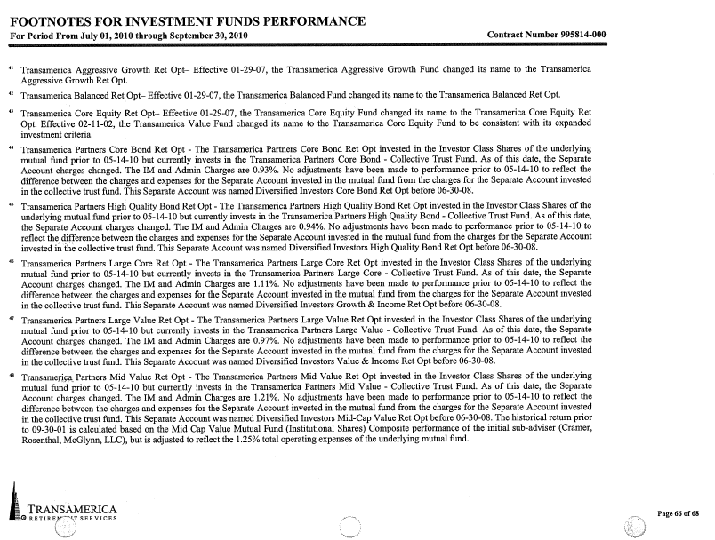
Disclosure ≠ Voluntary Informed Consent
The IM and Admin Charges are 0.93%
The IM and Admin Charges are 0.94%
The IM and Admin Charges are 1.11%
The IM and Admin Charges are 0.97%
The IM and Admin Charges are 1.21%
Page 66 of 68

Slide 41
Disclosure ≠ Voluntary Informed Consent
Revenue Sharing
American Funds – EuroPacific Fund
Fee / Share Class | A | R-1 | R-2 | R-3 | R-4 | R-5 | R-6
Management Fee | 0.43% | 0.43% | 0.43% | 0.43% | 0.43% | 0.43% | 0.43%
Distribution and/or 12b-1 Fees | 0.24% | 1.00% | 0.75% | 0.50% | 0.25% | none | none
Sub-TA and Other Fees | 0.18% | 0.21% | 0.48% | 0.22% | 0.18% | 0.13% | 0.09%
Total Expense Ratio | 0.85% | 1.64% | 1.66% | 1.15% | 0.86% | 0.56% | 0.52%
Annual Cost per $1MM | $8,500 | $16,400 | $16,600 | $11,500 | $8,600 | $5,600 | $5,200

Slide 42
Disclosure ≠ Voluntary Informed Consent
Revenue Sharing
American Funds – EuroPacific Fund
Fee / Share Class | A | R-1 | R-2 | R-3 | R-4 | R-5 | R-6
Management Fee | 0.43% | 0.43% | 0.43% | 0.43% | 0.43% | 0.43% | 0.43%
Distribution and/or 12b-1 Fees | 0.24% | 1.00% | 0.75% | 0.50% | 0.25% | none | none
Sub-TA and Other Fees | 0.18% | 0.21% | 0.48% | 0.22% | 0.18% | 0.13% | 0.09%
Total Expense Ratio | 0.85% | 1.64% | 1.66% | 1.15% | 0.86% | 0.56% | 0.52%
Annual Cost per $1MM | $8,500 | $16,400 | $16,600 | $11,500 | $8,600 | $5,600 | $5,200

Slide 43
Disclosure ≠ Voluntary Informed Consent
Revenue Sharing
American Funds – EuroPacific Fund
Fee / Share Class | A | R-1 | R-2 | R-3 | R-4 | R-5 | R-6
Management Fee | 0.43% | 0.43% | 0.43% | 0.43% | 0.43% | 0.43% | 0.43%
Distribution and/or 12b-1 Fees | 0.24% | 1.00% | 0.75% | 0.50% | 0.25% | none | none
Sub-TA and Other Fees | 0.18% | 0.21% | 0.48% | 0.22% | 0.18% | 0.13% | 0.09%
Total Expense Ratio | 0.85% | 1.64% | 1.66% | 1.15% | 0.86% | 0.56% | 0.52%
Annual Cost per $1MM | $8,500 | $16,400 | $16,600 | $11,500 | $8,600 | $5,600 | $5,200

Slide 44
Disclosure ≠ Voluntary Informed Consent
Revenue Sharing
American Funds – EuroPacific Fund
Fee / Share Class | A | R-1 | R-2 | R-3 | R-4 | R-5 | R-6
Management Fee | 0.43% | 0.43% | 0.43% | 0.43% | 0.43% | 0.43% | 0.43%
Distribution and/or 12b-1 Fees | 0.24% | 1.00% | 0.75% | 0.50% | 0.25% | none | none
Sub-TA and Other Fees | 0.18% | 0.21% | 0.48% | 0.22% | 0.18% | 0.13% | 0.09%
Total Expense Ratio | 0.85% | 1.64% | 1.66% | 1.15% | 0.86% | 0.56% | 0.52%
Annual Cost per $1MM | $8,500 | $16,400 | $16,600 | $11,500 | $8,600 | $5,600 | $5,200

Slide 45
Disclosure ≠ Voluntary Informed Consent
Revenue Sharing
American Funds – EuroPacific Fund
Fee / Share Class | A | R-1 | R-2 | R-3 | R-4 | R-5 | R-6
Management Fee | 0.43% | 0.43% | 0.43% | 0.43% | 0.43% | 0.43% | 0.43%
Distribution and/or 12b-1 Fees | 0.24% | 1.00% | 0.75% | 0.50% | 0.25% | none | none
Sub-TA and Other Fees | 0.18% | 0.21% | 0.48% | 0.22% | 0.18% | 0.13% | 0.09%
Total Expense Ratio | 0.85% | 1.64% | 1.66% | 1.15% | 0.86% | 0.56% | 0.52%
Annual Cost per $1MM | $8,500 | $16,400 | $16,600 | $11,500 | $8,600 | $5,600 | $5,200

Slide 46
Disclosure ≠ Voluntary Informed Consent
Revenue Sharing
American Funds – EuroPacific Fund
Fee / Share Class | A | R-1 | R-2 | R-3 | R-4 | R-5 | R-6
Management Fee | 0.43% | 0.43% | 0.43% | 0.43% | 0.43% | 0.43% | 0.43%
Distribution and/or 12b-1 Fees | 0.24% | 1.00% | 0.75% | 0.50% | 0.25% | none | none
Sub-TA and Other Fees | 0.18% | 0.21% | 0.48% | 0.22% | 0.18% | 0.13% | 0.09%
Total Expense Ratio | 0.85% | 1.64% | 1.66% | 1.15% | 0.86% | 0.56% | 0.52%
Annual Cost per $1MM | $8,500 | $16,400 | $16,600 | $11,500 | $8,600 | $5,600 | $5,200

Slide 47
Disclosure ≠ Voluntary Informed Consent
Revenue Sharing
American Funds – EuroPacific Fund
Fee / Share Class | A | R-1 | R-2 | R-3 | R-4 | R-5 | R-6
Management Fee | 0.43% | 0.43% | 0.43% | 0.43% | 0.43% | 0.43% | 0.43%
Distribution and/or 12b-1 Fees | 0.24% | 1.00% | 0.75% | 0.50% | 0.25% | none | none
Sub-TA and Other Fees | 0.18% | 0.21% | 0.48% | 0.22% | 0.18% | 0.13% | 0.09%
Total Expense Ratio | 0.85% | 1.64% | 1.66% | 1.15% | 0.86% | 0.56% | 0.52%
Annual Cost per $1MM | $8,500 | $16,400 | $16,600 | $11,500 | $8,600 | $5,600 | $5,200

Slide 48
Disclosure ≠ Voluntary Informed Consent
Revenue Sharing
American Funds – EuroPacific Fund
Fee /Share Class | A | R-1 | R-2 | R-3 | R-4 | R-5 | R-6
Management Fee | 0.43% | 0.43% | 0.43% | 0.43% | 0.43% | 0.43% | 0.43%
Distribution and/or 12b-1 Fees | 0.24% | 1.00% | 0.75% | 0.50% | 0.25% | none | none
Sub-TA and Other Fees | 0.18% | 0.21% | 0.48% | 0.22% | 0.18% | 0.13% | 0.09%
Total Expense Ratio | 0.85% | 1.64% | 1.66% | 1.15% | 0.86% | 0.56% | 0.52%
Annual Cost per $1MM | $8,500 | $16,400 | $16,600 | $11,500 | $8,600 | $5,600 | $5,200

Slide 49
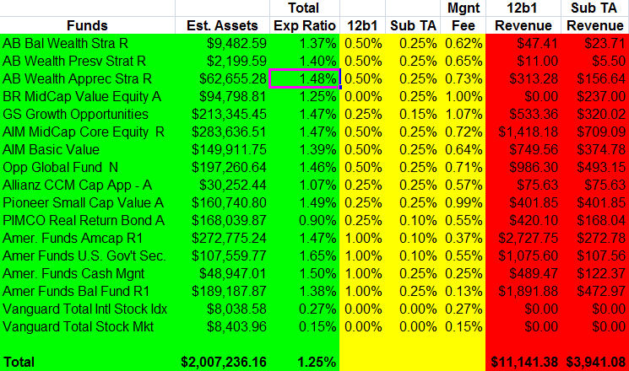
Voluntary UNinformed Consent

Slide 50
Voluntary UNinformed Consent
$7,726.30 Hard Dollar
$11,141.38 12(b)(1) fees
$3,941.08 Sub-TA fees
$22,808.76 Total (67.7% higher )
$15,082.46 Unknown to Plan Sponsor

Slide 51
What if the plan sponsor fails to spot excessive Compensation?
Penalty of Voluntary UNinformed Consent
  Both the plan sponsor and the service provider engaged in a PT.
  The service provider’s PT is the receipt of the excessive compensation;
  The plan sponsor’s PT is that it allowed the plan to pay unreasonable compensation.
“In these circumstances, there is no relief for the plan sponsor or for the service provider.” Fred Reish, Esq.

Slide 52
Suitability & Fiduciary Standards
Fiduciary Standard
under the
Investment Advisors Act
Registered Investment Advisor
Investment Advisor
Suitability Standard
under the
Securities Exchange Act
  Registered Representative
  Stockbroker
Marketing Terms not found in the Law
    Financial Consultant
    Financial Advisor
    Co-fiduciary

Slide 53
The 2010 ORC/Infogroup Survey
Suitability & Fiduciary Standards
60% of U.S. investors mistakenly think that insurance agents have a fiduciary duty to their clients.
66% of U.S. investors are incorrect in thinking that stockbrokers are held to a fiduciary duty.
76% of investors are wrong in believing that “financial advisors” – a term used by brokerage firms to describe their salespeople - are held to a fiduciary duty.
Notes:
Slides 11-14 in response to “our broker handles all that stuff.”

Slide 54
Suitability & Fiduciary Standards
“Make a habit of two things: to help, or at least, to do no harm.” Hippocrates 400BC
Beneficence: an affirmative obligation that means “do good.”
- One ought to act in ways that promote the well-being of others.
Non-maleficence: a negative obligation that means “do no harm.”
- One ought to act in ways that do not cause harm to others.*
*Includes the negative obligation not to do harm inadvertently
or by carelessness, or malice or negligence.

Slide 55
Suitability & Fiduciary Standards
The Suitability Standard: a broker must have a reasonable basis to believe that a recommended investment is suitable given the client’s objectives.
Or
Non-Maleficence / Do no harm
The Fiduciary Standard: an advisor must put the client’s interests above their own, and act in the client’s best interest.
Or
Beneficence / Do good

Slide 56
Moral Hazard of Suitability
“Many brokers and insurance companies “throw around the "fiduciary" word with abandon and mislead employers into believing they will share legal responsibility in the event of a lawsuit concerning plan choices.”
Dan Solin, The 401(k) Sucker Punch
Regarding Phantom Fiduciaries: “They get to throw around the word "fiduciary"--without being on the hook for any real fiduciary responsibility (and therefore liability) to plan fiduciaries.”
W. Scott Simon, Fiduciary Focus: Non Fiduciary Investment Consultants

Slide 57
Moral Hazard of Suitability
Suitability Standard of Care (Rules Based)
Sales standard developed by industry Permitted to place their self interests ahead of client’s Commission based compensation
General investment advice incidental to sales transaction
Work for and represent their firm
Recommendations must be suitable based upon the clients Age Time horizon Risk tolerance
Fiduciary Standard of Care (Principles Based)
Same as Doctors, Attorneys & CPAs Client’s best interests always first. Period! Fee-based compensation
Provide specific and formal investment advice
Work for and represent the client
In addition to suitability standard, RIA’s are legally obligated to Assume liability for recommendations Disclose all conflicts of interest Resolve all conflicts in favor of the client Control and account for fees Disclose compensation

Slide 58
Moral Hazard of Suitability
“If I know he’s a salesman, I will evaluate his recommendations differently,…When he is an adviser, I don’t question him, I assume he is a better expert than I am.”
Professor Tamar Frankel, Boston University
“The greatest risk the average investor runs is the risk of being misled into thinking that the broker is acting in the best interest of the client, as opposed to acting in the firm’s interest.”
Professor Arthur Laby, Rutgers School of Law

Slide 59
Moral Hazard of Suitability
“a fiduciary’s duties are the highest known to the law, a trustee is held to something stricter than the morals of the market place…” Donovan v. Bierwirth, 680 F.2d 263 (2nd Cir. 1982)
What is suitable when dealing with a client who is a fiduciary?
For example, a 401k plan sponsor.
Non-Maleficence / Do no harm
or
Beneficence / Do good
Which protects a plan sponsor from moral hazard?

Slide 60
Suitability Standard in Action
“Unless they possess the necessary expertise to evaluate such factors, fiduciaries would need to obtain the advice of a qualified, independent expert.” DOL Reg. § 2509.95-1(c)(6)
  “For many plan sponsors, investment and other fiduciary responsibilities can seem overwhelming. That’s where we can help.”
  “We are dedicated to making your retirement plan a success and, at the same time, helping you meet your fiduciary responsibilities.”
The Services Available to your 401(k) Plan
  “When it comes to meeting your complete fiduciary responsibilities as a retirement plan sponsor, there are many considerations XYZ can help you make sense of it all.” Your Responsibilities as a Retirement Plan Sponsor

Slide 61
Suitability Standard in Action
West Point Cadets violate the Honor Code by lying if they deliberately deceive another by stating an untruth or by any direct form of communication to include the telling of a partial truth and the vague or ambiguous use of information or language with the intent to deceive or mislead.
At West Point, this form of lying is called “quibbling.”
Ethically speaking quibbling is called “paltering.”

Slide 62
Suitability Standard in Action
Palter - to intentionally deceive or mislead without making a false statement in order to advantage one’s self and /or disadvantage another.
The 401k industry is fraught with paltering and puffery which contributes to the moral hazard
facing retirement plan sponsors!

Slide 63
Suitability Standard in Action
 | 1 mo. | 3 mos. | YTD | 1 yr. | 3 yrs. | 5 yrs. | 10 yrs. | Since* Inception | Expense Ratio
Vanguard Target Retirement 2030 Ret Opt | -0.54 | 10.59 | 7.58 | 9.53 | -3.67 | N/A | N/A | 1.90 | 0.94
Performance shown is average annual total separate account investment choice
returns (except 1 month, last quarter, and year-to-date) for the period indicated,
net of the total operating expenses of the separate account or underlying investment
as listed on the individual investment fact sheets. Performance returns reflect
reinvestment of dividends and capital gains distributions. Application of the contract
asset charge and any discontinuance charges or service fees deducted from the
account would reduce this return.
Group Annuity 401k Participant Website

Slide 64
Suitability Standard in Action
Professor Marvel’s Magical Elixir = Fiduciary Warranties
  “…we are committed to helping you meet the highest fiduciary standards in the investment selection and monitoring process and commit to restore losses and pay litigation costs in the event that legal action is brought against qualifying plans. Now that’s security for your plan!”
“Review the minimum Fund requirements and a copy of the Warranty Certificate (PS 9613) to see if your plan qualifies.”

Slide 65
Suitability Standard in Action
Professor Marvel’s Magical Elixir = Fiduciary Warranties
“Also, since past performance is not a guarantee of future results, we cannot warrant or guarantee either that any investment option will yield any specific return, or even that it will yield a positive return. Nor does our Fiduciary Standards Warranty extend to claims that any expenses paid directly or indirectly by the Plan are reasonable.”
John Hancock Warranty Certificate, PS9613, 12/05 – 10024

Slide 66
Suitability Standard in Action
Fiduciary Delegation
ERISA §3(21) “Full-scope” Fiduciary
≠ ERISA §3(21)(a)(ii) Limited-scope Fiduciary
While a “Full-scope 3(21)” or ERISA 402(a) fiduciary can truly protect plan sponsors by assuming responsibility and decision making authority, a limited-scope 3(21)(a)(ii) assumes no true responsibility, and therefore, provides no protection from fiduciary liability.

Slide 67
Suitability Standard in Action
An ERISA 3(38) Investment Manager assumes discretion, and therefore potential liability, for investment decisions including the reasonableness of the fees for the investments he/she chooses.
Another fiduciary warranty:
“Our responsibility as a fiduciary is for the prudent investment management of the assets in participants‘ accounts over which ABC Money Management has discretionary control. In that capacity, we hereby represent, warrant and covenant that: ABC Money Management satisfies the criteria in section 3(38) of ERISA to be an “investment manager.”

Slide 68
Suitability Standard in Action
“The Warranty does not cover any Claim or Loss resulting from, or in any manner related to, the fees and expenses, direct or indirect, of the investments or of the Program. This includes, for example (but is not limited to), any expenses charged to or by any mutual funds, or plan providers or advisers.”
“The Plan fiduciaries must consider any such fees and expenses and compare them to the value received by the Plan and the participants and to the cost of similar investments and services.”

Slide 69
Parting Thoughts
  Professional Responsibility Professional Development
  Ethical Leadership Fairness & Justice
  Conflicts of Interest Use of Information
Encourage us in our endeavor to live above the common level of life. Make us to choose the harder right instead of the easier wrong, and never be content with a half-truth when the whole can be won. West Point Cadet Prayer

Slide 70

Parting Thoughts

Slide 71
www.PrudentChampion.com
Fiduciary Plan Governance, LLC nor Mark D. Mensack, LLC. are investment advisory firms and do not provide any investment-related services. We are an expert resource actively engaged in advising, training and supporting broker/dealers, registered representatives, registered investment advisors, trustees and other fiduciaries in effectively meeting their responsibilities.
Please contact us for further information on how we can strengthen and broaden your professional services. Our team is looking forward to working with you.
Boston | Great Lakes | Los Angeles | Nashville | New York Metro | Tampa | Philadelphia | Washington, D.C.
(856) HIT-401K | www.fiduciaryplangovernance.com
Mark@PrudentChampion.com

